Slide 1

Managing Data Leakage
Mitigation and prevention techniques
By: Arewa Morountudun Ojelade
Notes:
Pseudonym : Arewa Iyi
Bio information : Graduate student studying Data Analytics
Machine learning is a subcategory of data analytics and my targeted concentration
I am also the main organizer for
Miami Machine learning
PyData Miami
Skill up and network orlando

Slide 2
What is Data leakage in machine learning?
Data leakage in Machine Learning is a type of error that “... causes a predictive model to look accurate until deployed in its use case; then, it will yield inaccurate results, leading to poor decision-making and false insights.”
A.
B.
C.
False Perspective
Inaccurate results after use-case deployment.
Poor decision-making
Reference: IBM-What is Data Leakage in Machine Learning By Tim Mucci

Slide 3
Data Leakage
Causes
Inclusion of future information
Inappropriate feature selection
External data contamination
Data processing errors
Improper Normalization
Validation and process changes leakage

Slide 4
Prevention Techniques
“To prevent Data leakage, organizations must engage in careful data handling and systematic evaluation”
A.
B.
C.
Appropriate Data preprocessing
Proper Feature engineering
Regular model evaluation
Mucci, T. (2024, September 30). Data leakage in machine learning. Ibm.com. https://www.ibm.com/think/topics/data-leakage-machine-learning

Slide 5
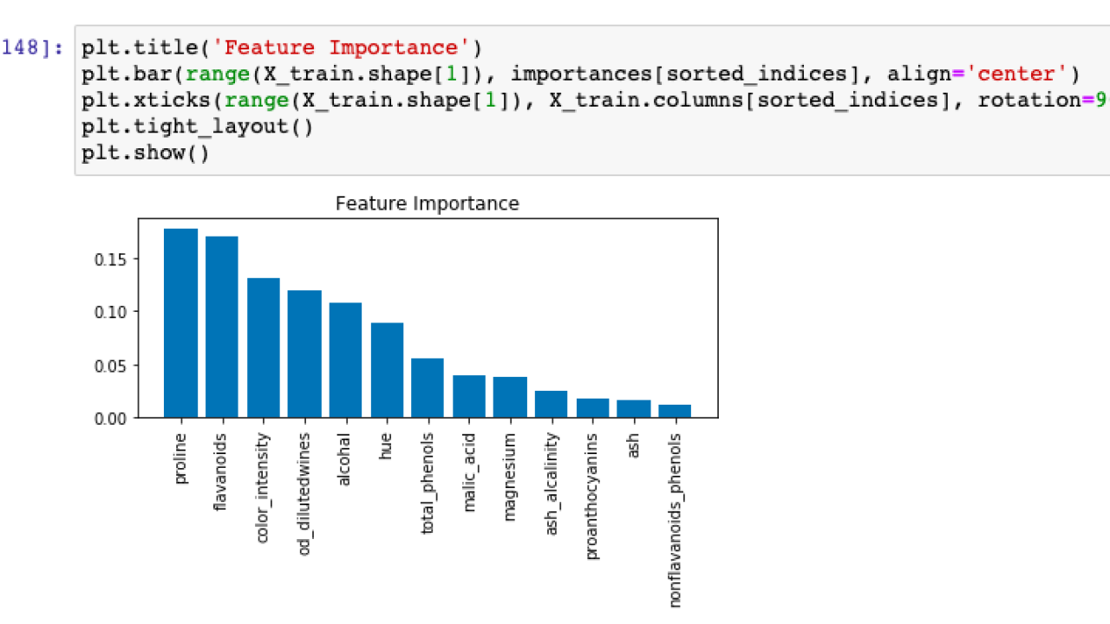

Proper Evaluation

Slide 6
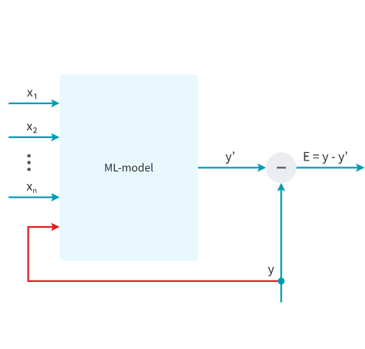
eXAMPLE
Target Leakage Example:
A model to predict cancer containing a field with levels of aggression which is usually assessed after cancer has been detected introduces future information that would not be available in the real world use case.
Correlations to overfitting : In this case, the model is overfitting due to the levels of aggression giving away the classification of malignancy.
Mucci, T. (2024, September 30). Data leakage machine learning. Ibm.com. https://www.ibm.com/think/topics/data-leakage-machine-learning
Targeted leaks. (2023, December 20). MEGALADATA. https://megaladata.com/blog/data-leakage-machine-learning

Slide 7
Detection Techniques
“Detecting Data leakage requires organizations to be aware of how models are prepared and processed; it requires rigorous strategies for validating the integrity of machine learning models.”
A.
B.
C.
Prepare/Search/Test
Unusually high performance during testing.
Unexpected model behavior.
Mucci, T. (2024, September 30). Data leakage in machine learning. Ibm.com. https://www.ibm.com/think/topics/data-leakage-machine-learning

Slide 8
Mitigation techniques
01.
Monitor correlation of all engineered features prior to model training.
02.
Monitor correlation of features post data transformations such as scaling or normalizing features.
03.
Drop features that introduce future data.
04.
Ensure proper validation processes.
No partway or cross validation reruns.
05.
If removal of feature is not advisable, reduce the weights with regularization.
06.
It is not always obvious that certain features will not always be available after model deployment.
Always recheck!
Mucci, T. (2024, September 30). Data leakage machine learning. Ibm.com. https://www.ibm.com/think/topics/data-leakage-machine-learning

Slide 9
Conclusion
“A national library of medicine study found that across 17 different scientific fields where machine learning methods have been applied, at least 294 scientific papers were affected by data leakage, leading to overly optimistic performance.”
A.
B.
C.
Many are quick to blame model engineers for data leakage. To some extent this is true, but it is a common mistake!
As discussed there are preventative and mitigative measures that can be taken.
Always double check feature availability of use case after deployment.
Mucci, T. (2024, September 30). Data leakage machine learning. Ibm.com. https://www.ibm.com/think/topics/data-leakage-machine-learning

Slide 10

Thank You !
Managing Data Leakage
Mitigation and Prevention techniques
Presented by :
Miami Machine Learning
Email: arewa@neuraltransformers.org

